Slide 1


Crimes and Firearms Group IV

Slide 2
Agenda
Why this Data?
Source of the Data
Data Munging
Insights from Data
Brainstorming

Slide 3
Why this data?
Crime
Firearms
Deaths by Firearms
Unemployment

Slide 4

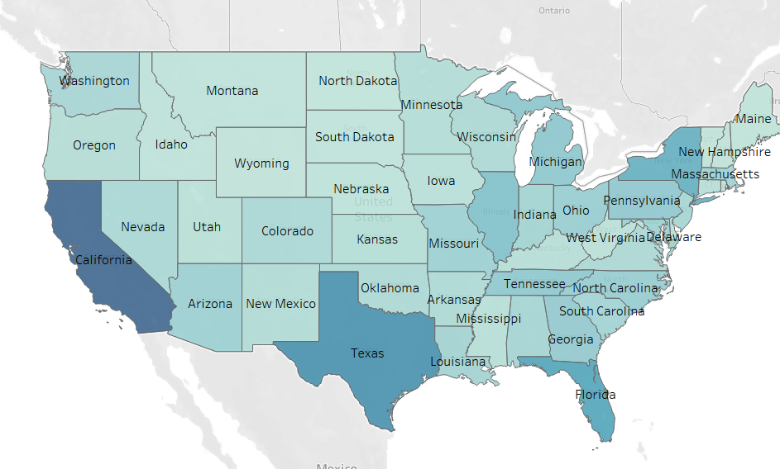
Crime Source: FBI

Slide 5
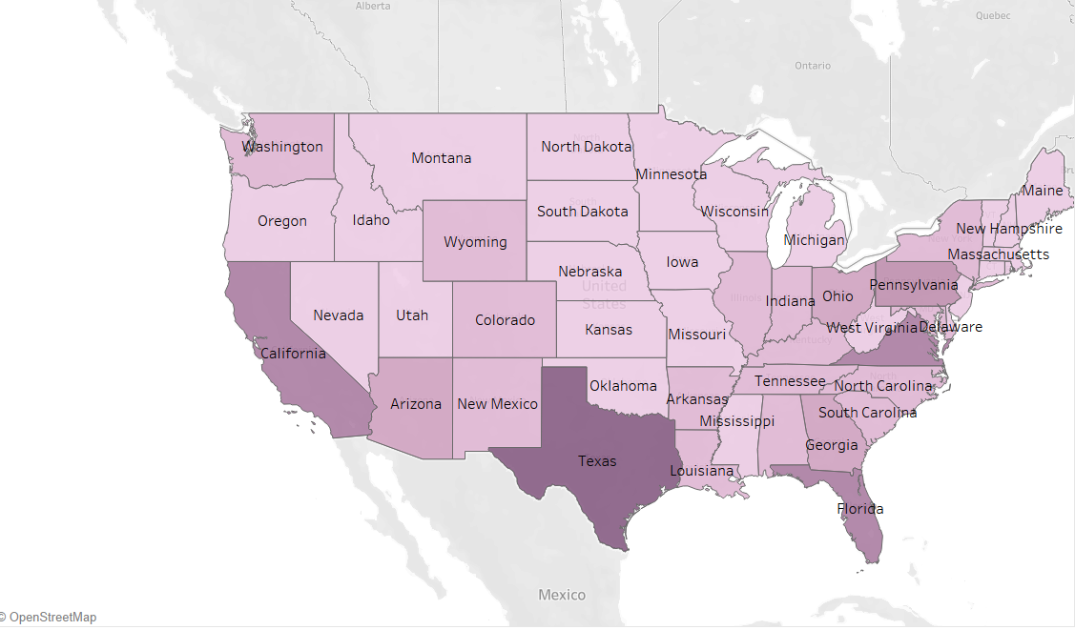
Firearms Source: Bureau of Alcohol, Tobacco, Firearms and Explosives (ATF)

Slide 6
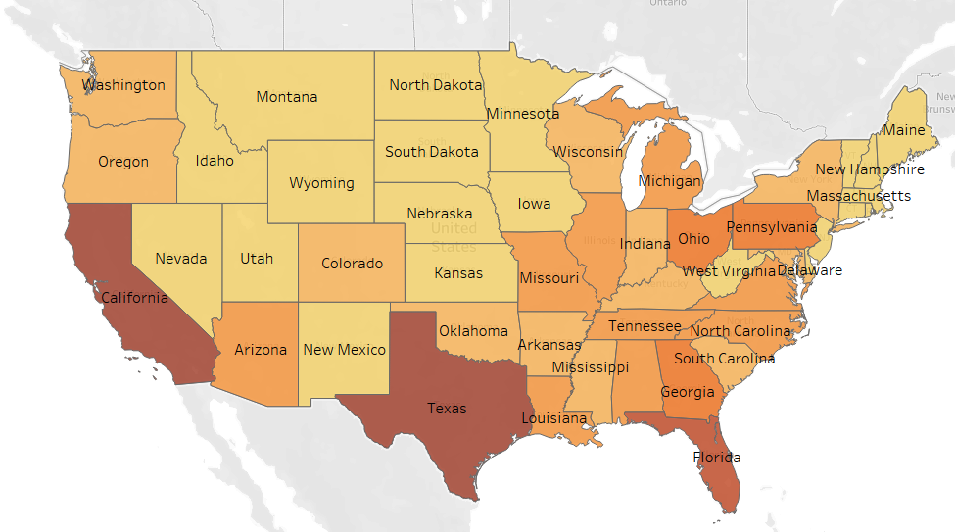
Death by Firearms Source: Center for Disease Control and Prevention (CDC)

Slide 7
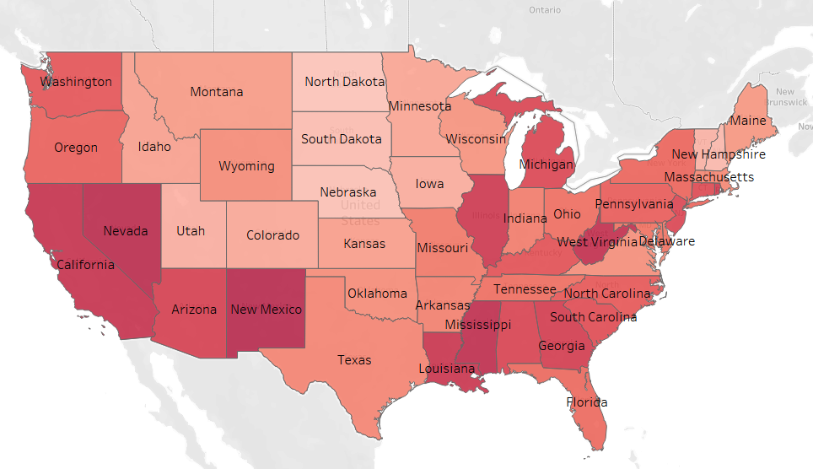
Unemployment Source: Bureau of Labor Statistics (BLS)

Slide 8
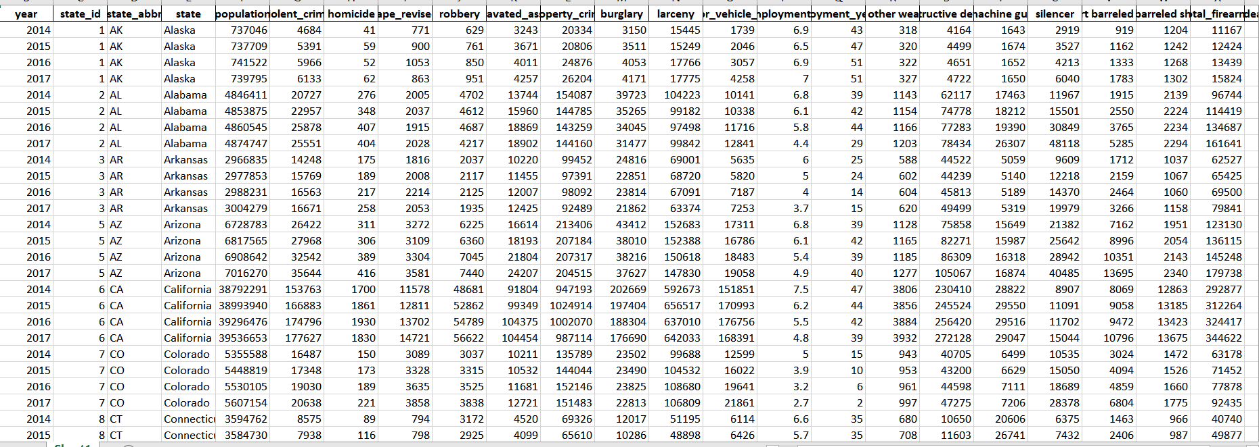
Data Munging
Removed null values
Changed data types
Renamed columns
Appended datasets
Merged datasets
Validated data

Slide 9
Insights from Data

Slide 10
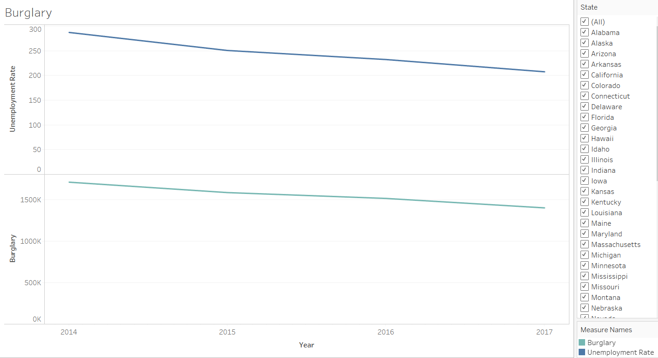
Unemployment and Burglary

Slide 11
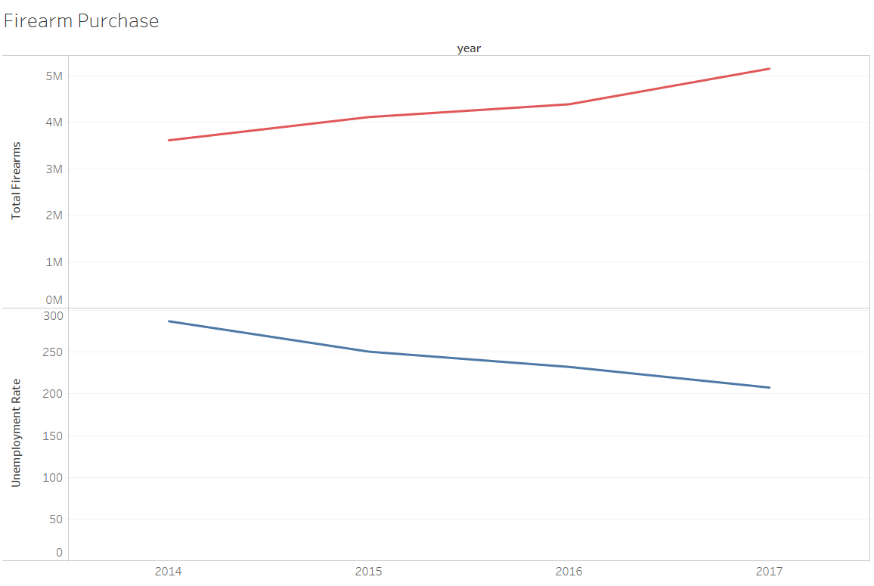
Unemployment and Firearms

Slide 12
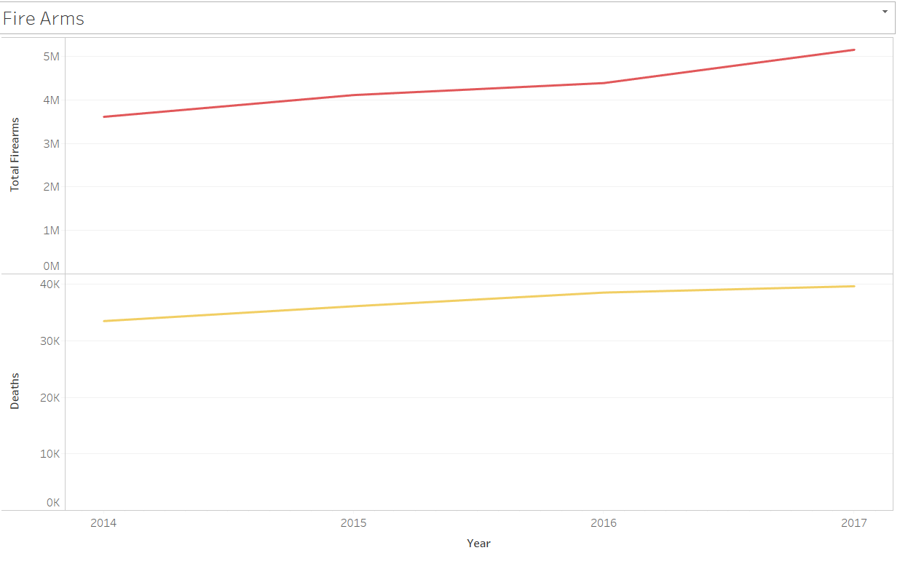
Firearms and Death by Firearms

Slide 13
Findings
As the rate of unemployment has decreased over the years, the amount of burglary crimes have also declined.
As the rate of unemployment has decreased over the years, the purchase of firearms have increased.
This indicates that people are buying guns for their personal safety after gaining employment.
As the number of total firearms has increased over the years, the amount death by firearms have also increased.

Slide 14
Case study: Suicides
Around 60% of the 175,700 US firearm deaths from 2012 to 2016 were suicides
Half of the 44,000 Americans who killed themselves in 2015 used a gun.
The easy availability of firearms to those in distress increases the likelihood of suicide attempts.
Source: BBC

Slide 15
Case study: What if guns disappeared?
The firearms industry accounts for $20 billion (£15 billion) in direct contributions, plus another $30 billion (£20 billion) in other contributions.
Gun death and injury-related expenses add up to direct losses of around $10.7 billion (£7 billion) per year, and more than $200 billion (£140 billion) when other factors are taken into account.
Source: BBC

Slide 16
That’s all folks!

